Slide 1
I
IASE VIRTUAL DIALOGUE
What my site is doing and how you can get involved
August 26th, 2023

Slide 2
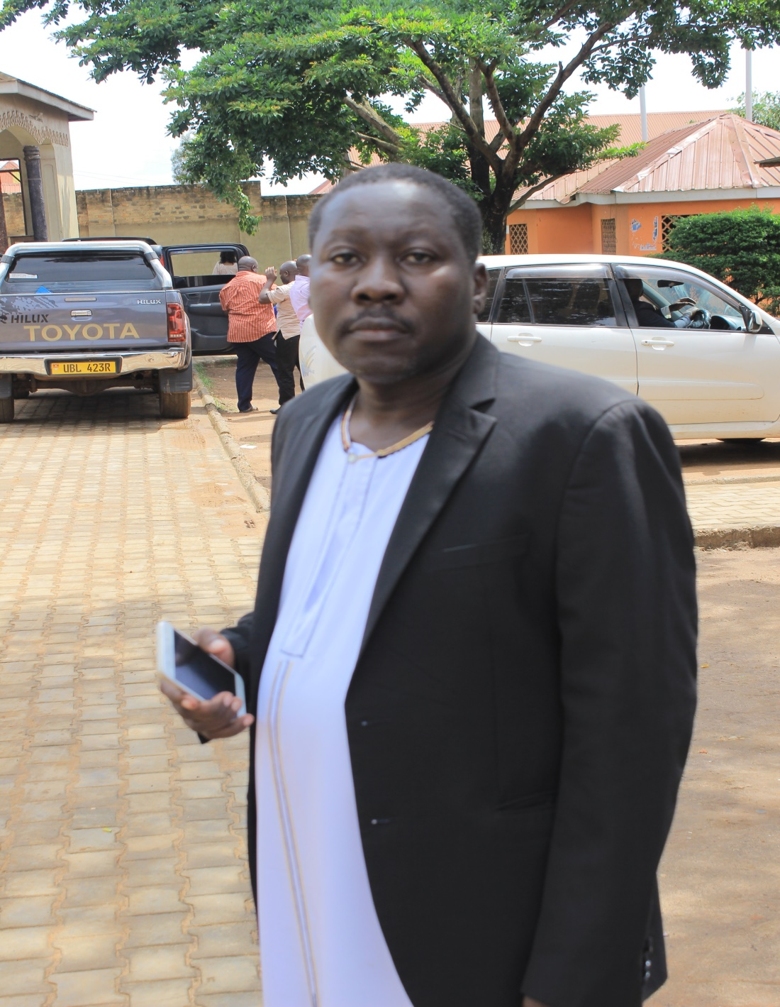

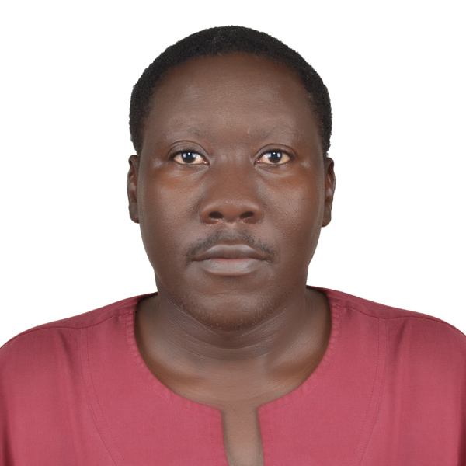
Moses Walusimbi
Founder / Director
Special Children Special People
Email: mwalusimbi@specialchildrenuganda.org
Website:
www.specialchildrenuganda.org

Slide 3
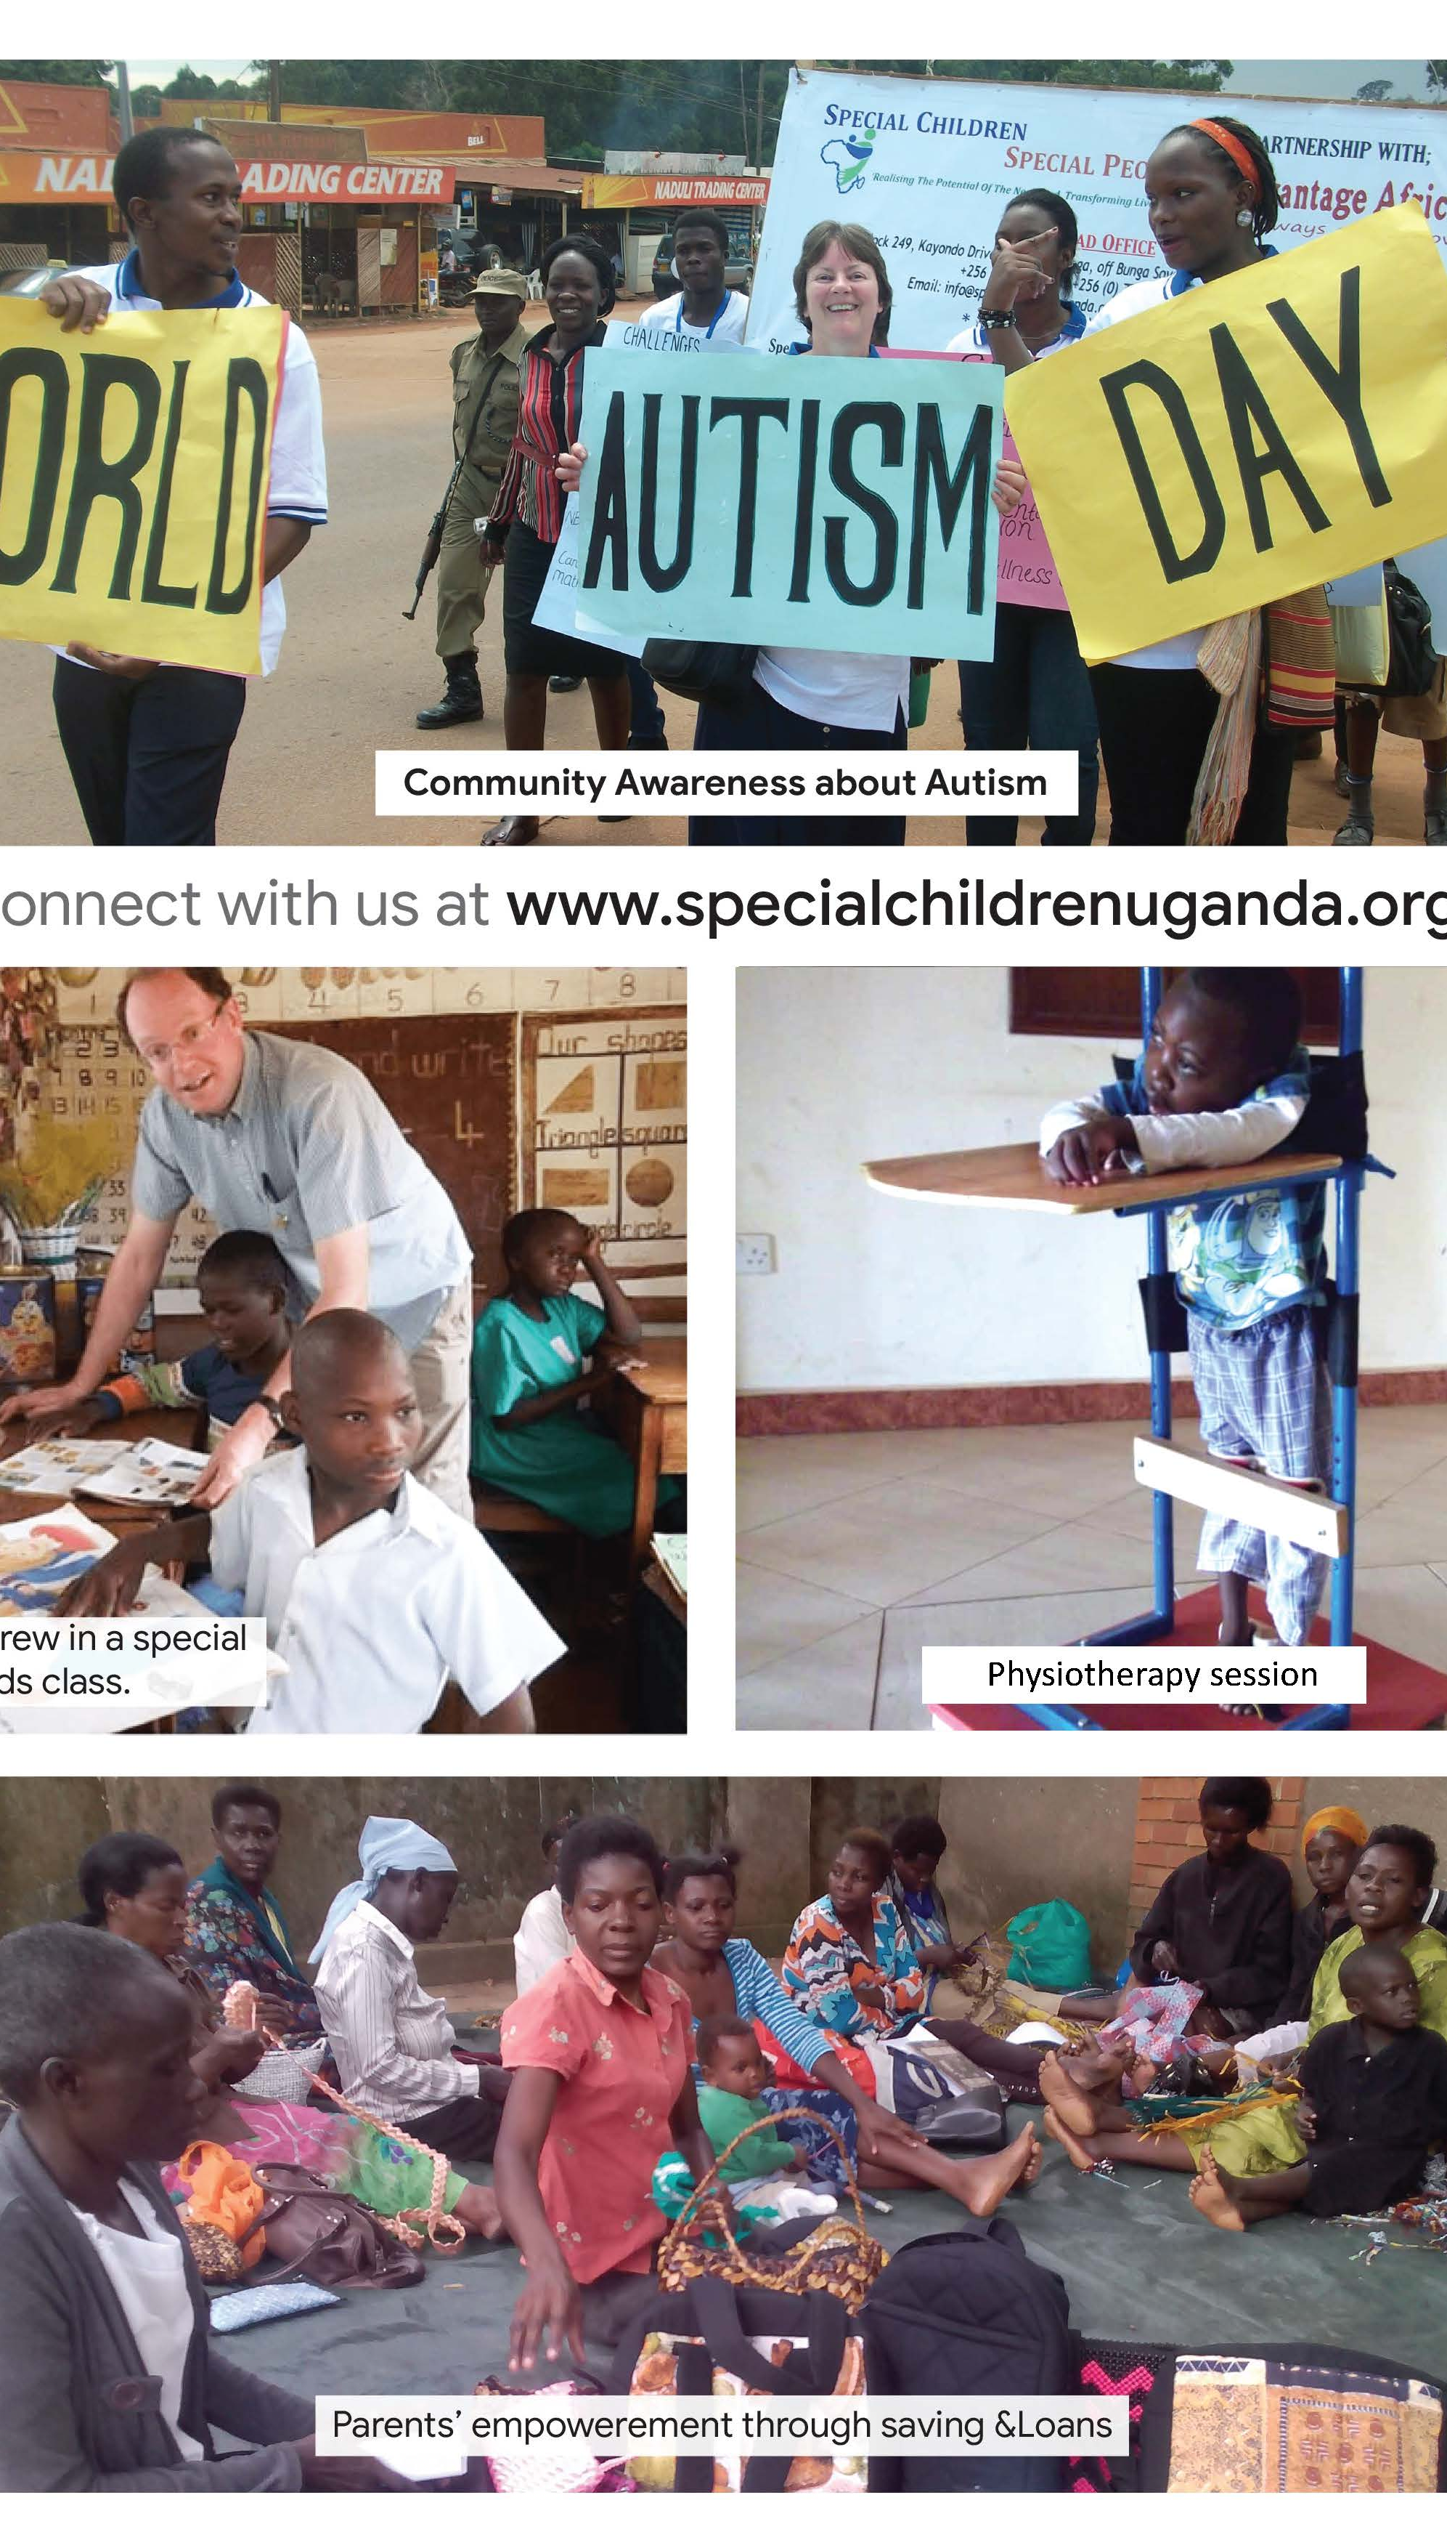
ABOUT US
Thematic Areas
Education and Rehabilitation
Advocacy and Awareness Raising
Economic empowerment

Slide 4
General Overview
Registered in 2012
Rehabilitation and therapeutic interventions, wheel chairs etc to over 500 children across the country.
Trained over 80 parent groups in community rehabilitation and intervention procedures.
SCSP was identified by the parliament of Uganda in 2016 and led a committee on nodding syndrome in northern Uganda.
Over 200 parent functional groups, micro credit program
Partnerships local and International
Annually host the goal event

Slide 5
CENTRE FOR NEURO INDEPENDENCE
We have 27 resident children
40 children under outreach program
Age 3 years to 17years
We also have young adults program
Cases handled
Autism, Cerebral Palsy,
Down syndrome, Intellectual Disabilities, Epilepsy

Slide 6
Services
Learning Assessment
Occupational therapy
Physiotherapy
Special needs Education
Speech and Language therapy
Vocational hands skilling
Behavior therapy
Music therapy

Slide 7
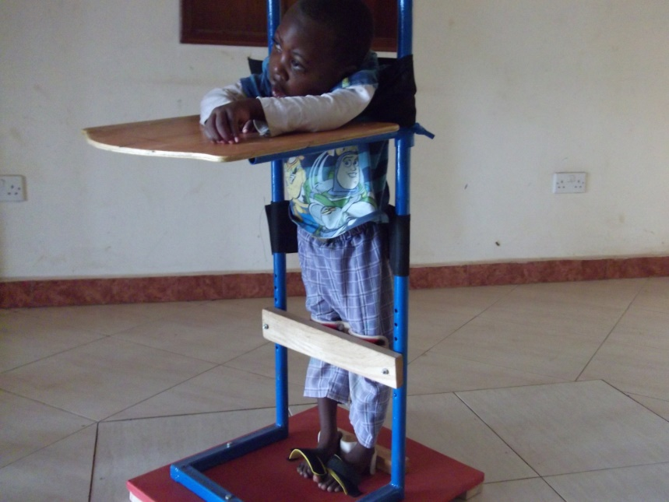
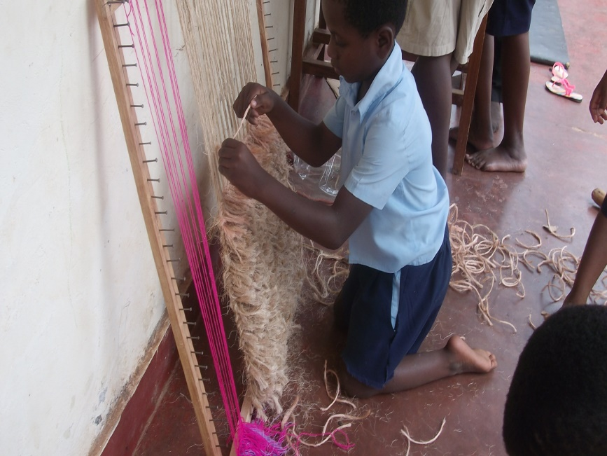
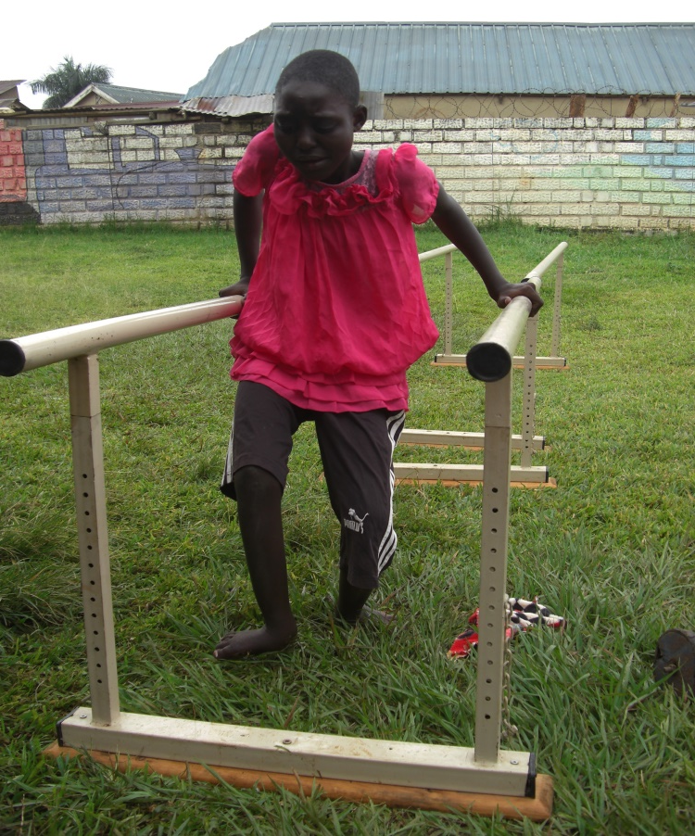
Physiotherapy
Vocational skilling

Slide 8
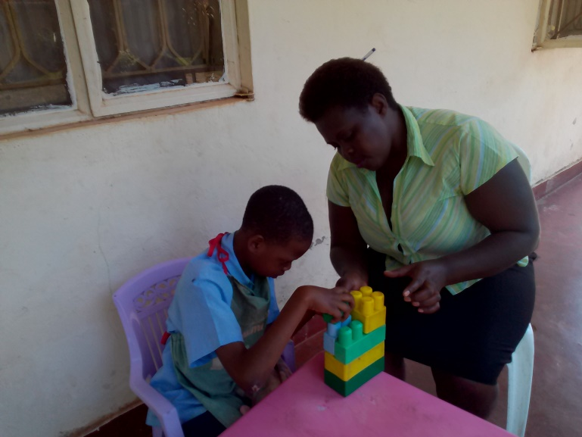
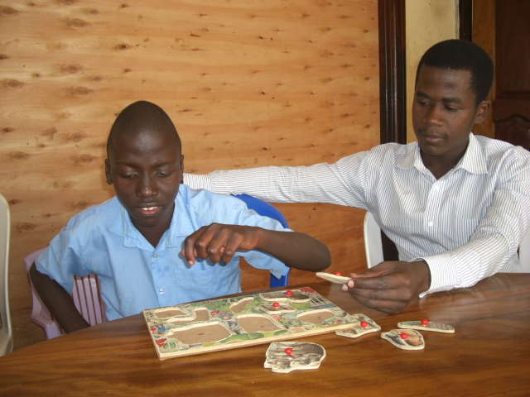
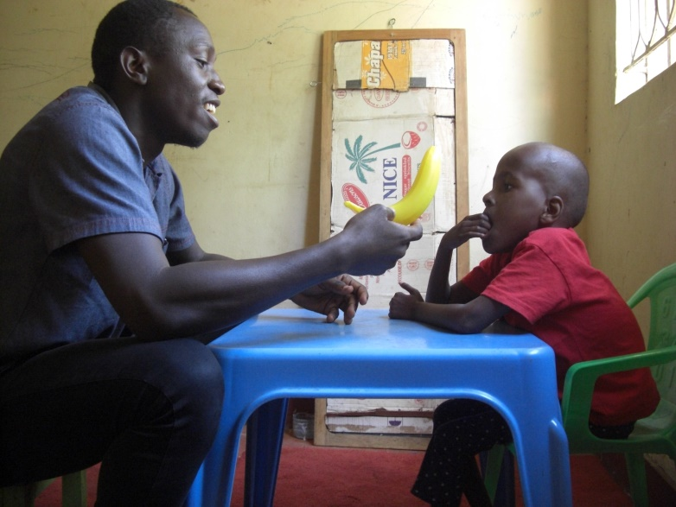
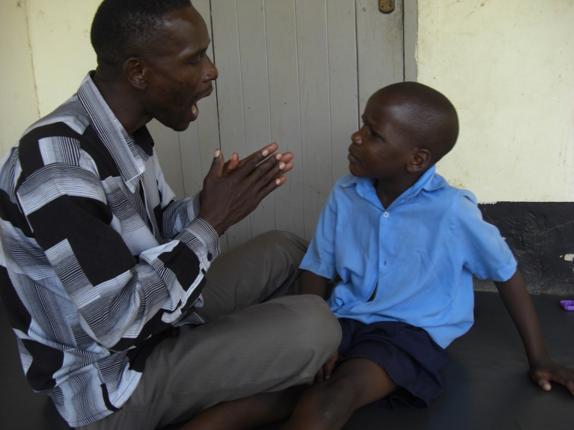
Occupational therapy
Speech and Language therapy

Slide 9

Started in 2019
To provide kindergarten and inclusive primary education
The concept of the school arrangement is unique to enroll children with disabilities.
For many years we had challenges of enrolling children into main stream schools.
Every child in the eligible age and qualification is welcome to a non-discriminatory school.

Slide 10
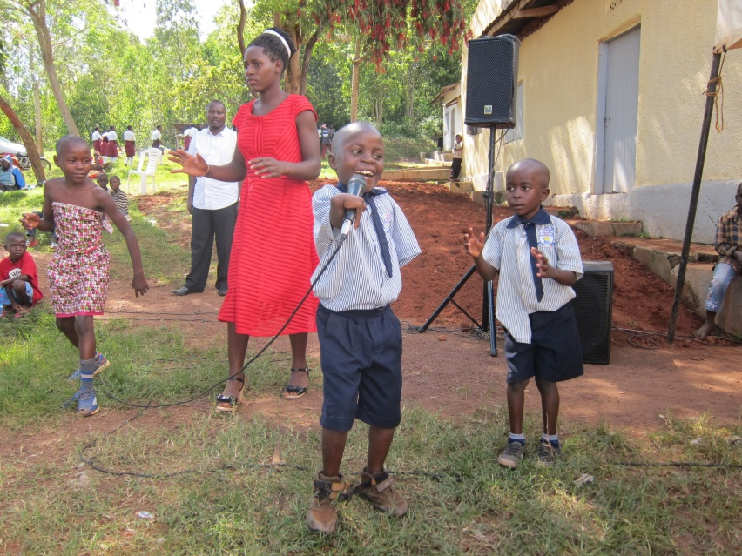
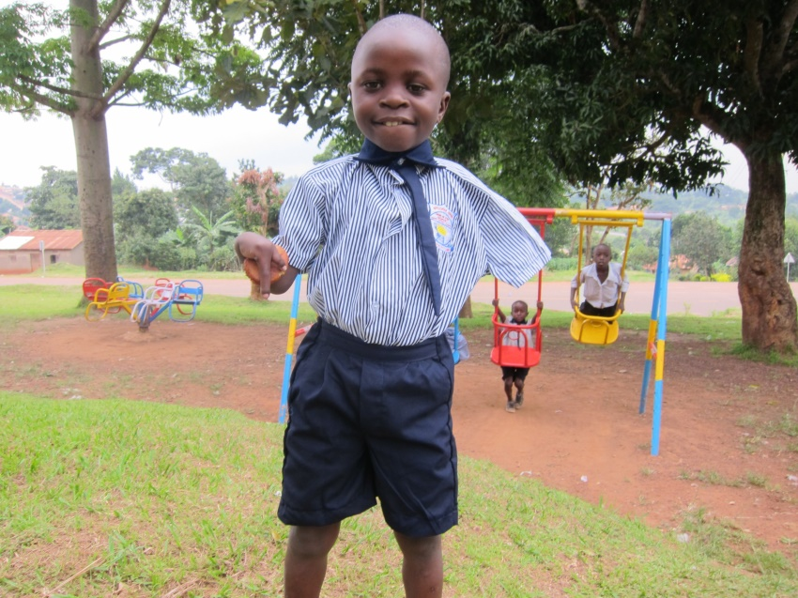
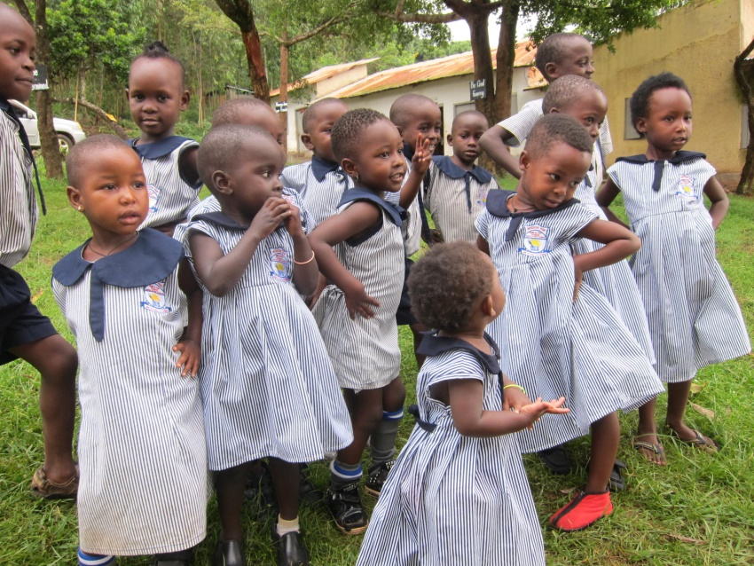
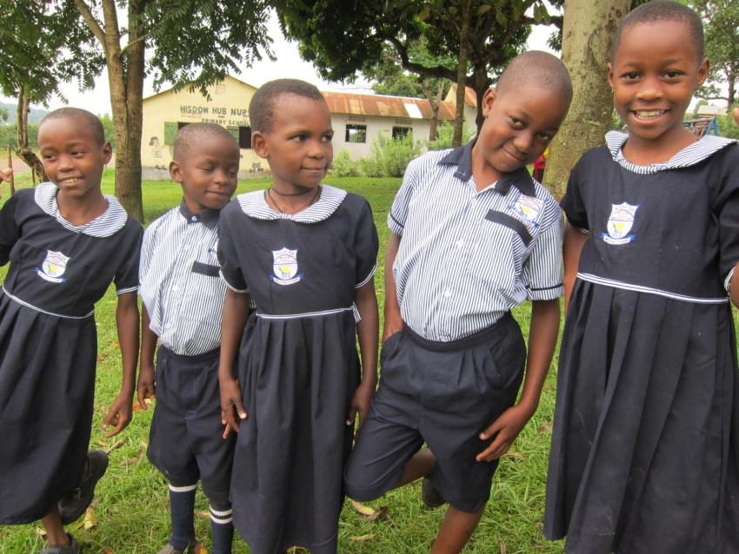
Wisdom Hub Nursery and Primary school

Slide 11
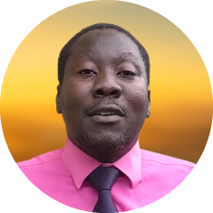
Introducing Digital Documentation in Uganda
Joined as Therap Global representative in 2019
Promotes Therap Global in Uganda
Building rapport with organizations working in the disabilities field, families, self-advocates, and anyone else using Therap
Moses Walusimbi
Therap Global Ambassador

Slide 12
About Therap Global
An online documentation software for organizations supporting persons with disabilities across globally.
Therap Global is an affiliate of Therap Services LLC.
Currently working with over 250 service providers in the Philippines, Bangladesh, Nepal, Indonesia, Kenya, South Africa, Tanzania, Uganda, Nigeria, and more countries
Access information remotely from anywhere
Track progress of learners easily
Generate different types of reports and share the reports with donors or guardians
Find records within seconds
Communicate easily with staffs or team members

Slide 13

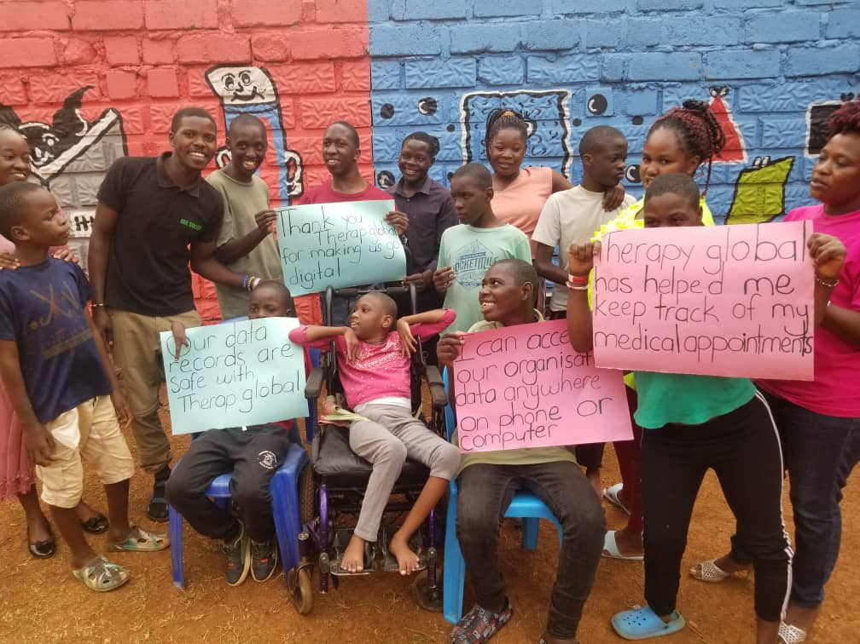

Slide 14
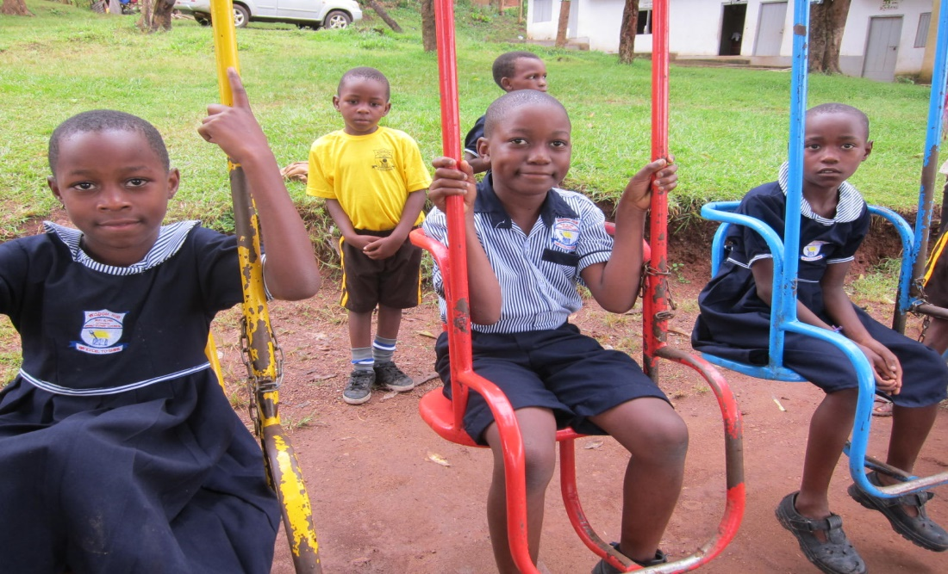
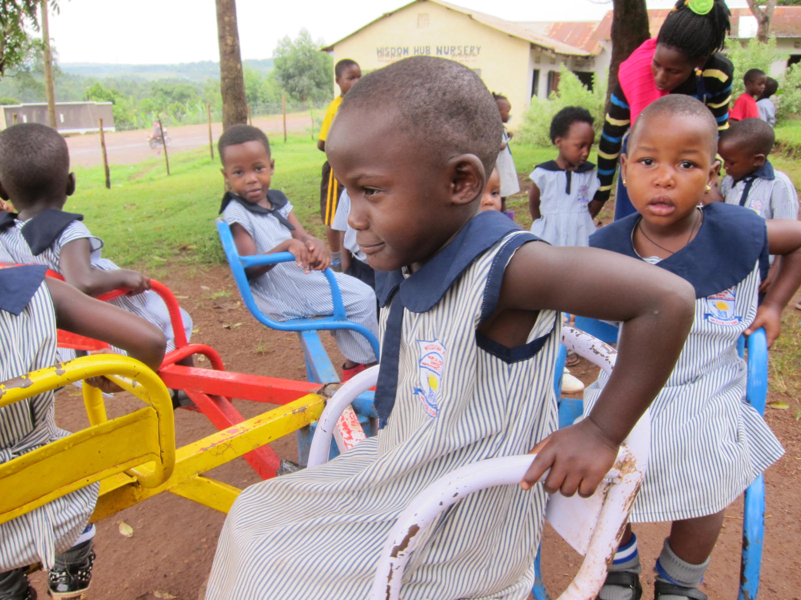
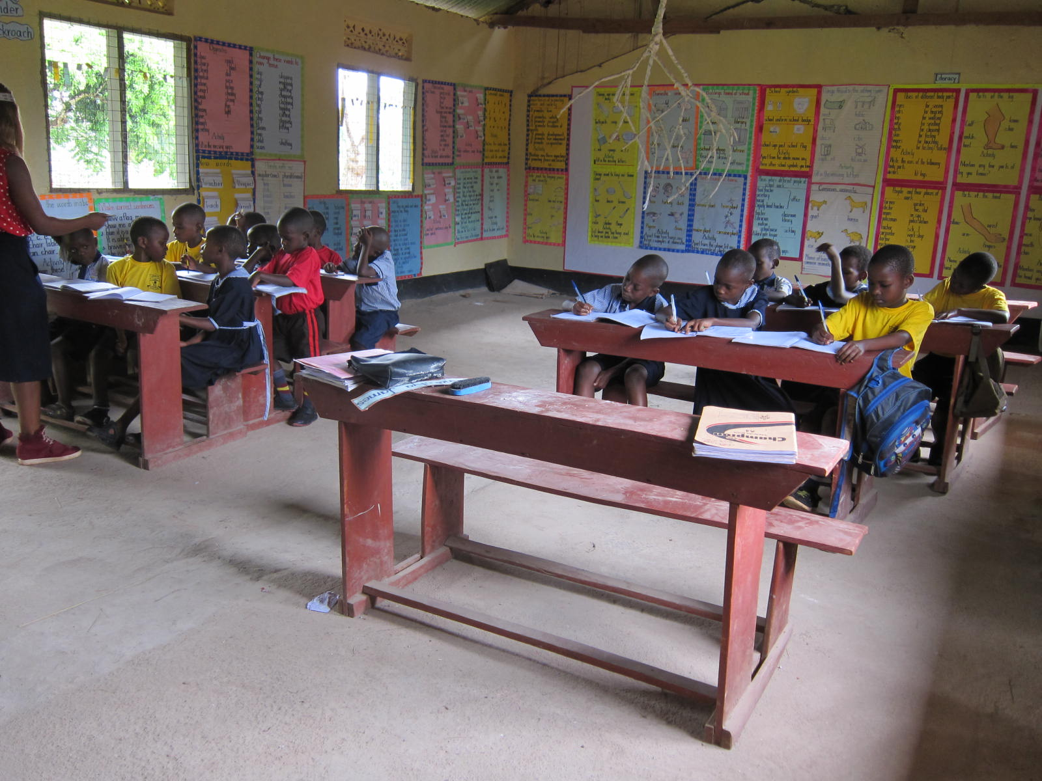
Support from IASE

Slide 15
How can you support
1 | Funds | To facilitate the building of the school Meet administrative costs
2 | Therapists | Directly work with children/families Train staff on best practices Work with the team during community visits /CBR
3 | Teachers | Teach children
4 | Facilitators | Build capacities of the team and administration Train teachers/therapists on inclusive education Outreach program
5 | Child sponsorship | To support a child towards achieving their set goals. Sponsor a child’s education
6 | Program sponsorship | For program sustainability

Slide 16
How can you support
7 | Technical teams | To set up classroom blocks and related activities
8 | Fundraisers | To tap into different funding opportunities
9 | Trustees | To set up a trustees’ board To guide the organization
10 | Social media influencers | To engage the social media audience To create social media content
11 | Gifts in kind/ Donations | Any gifts that can promote the programs of the organization.

Slide 17
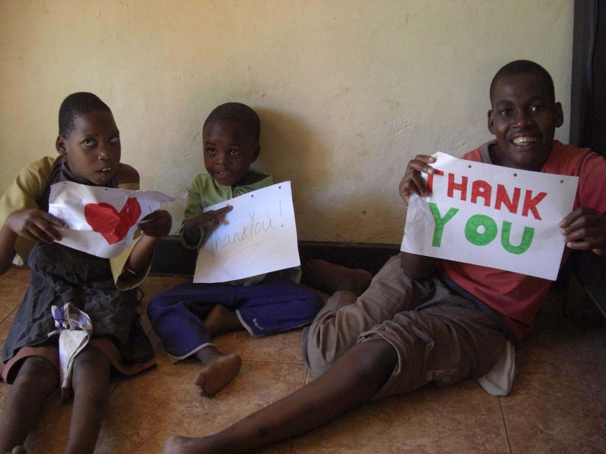
We passionately believe in the children that we support as an organisation, and helping families to bring them up as an integral part of our community.

